Slide 1
A Color Cube Example and
OpenGL Shading Language
(GLSL)
Sang Il Park
Dept. of Software

Slide 2
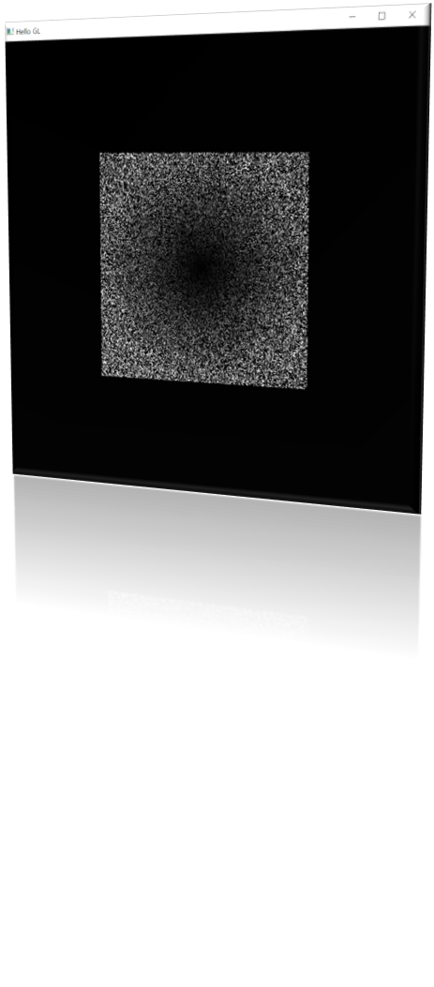
Review:
Setting for libraries
  Set include/lib folder
  #include <vgl.h>
  #include <initshader.h>
Creating data(in an array form)
Sending the data
  VAO – vertex array object
  VBO – vertex buffer object
Loading the shaders
Draw it with glDrawArrays(…)
Notes:
In order to initiate the rendering of primitives, you need to issue a drawing routine. While there are many routines for this in OpenGL, we’ll discuss the most fundamental ones. The simplest routine is glDrawArrays(), to which you specify what type of graphics primitive you want to draw (e.g., here we’re rending a triangle strip), which vertex in the enabled vertex attribute arrays to start with, and how many vertices to send.
This is the simplest way of rendering geometry in OpenGL Version 3.1. You merely need to store you vertex data in sequence, and then glDrawArrays() takes care of the rest. However, in some cases, this won’t be the most memory efficient method of doing things. Many geometric objects share vertices between geometric primitives, and with this method, you need to replicate the data once for each vertex. We’ll see a more flexible, in terms of memory storage and access in the next slides.

Slide 3

A Color Cube example

Slide 4
Rendering a Cube
We’ll render a cube with colors at each vertex
Our example demonstrates:
  initializing vertex data
  organizing data for rendering
  simple object modeling
    building up 3D objects from geometric primitives
    building geometric primitives from vertices
Notes:
The next few slides will introduce our first example program, one which simply displays a cube with different colors at each vertex. We aim for simplicity in this example, focusing on the OpenGL techniques, and not on optimal performance.

Slide 5
Initializing the Cube’s Data
We’ll build each cube face from individual triangles
Need to determine how much storage is required
  (6 faces)(2 triangles/face)(3 vertices/triangle)
  const int NumVertices = 36;
To simplify communicating with GLSL, we’ll use a vec4 class (implemented in C++) similar to GLSL’s vec4 type
#include <vec.h>
Notes:
In order to simplify our application development, we define a few types and constants to make our code more readable and organized.
Our cube, like any other cube, has six square faces, each of which we’ll draw as two triangles. In order to sizes memory arrays to hold the necessary vertex data, we define the constant NumVertices.
Additionally, as we’ll see in our first shader, the OpenGL shading language, GLSL, has a built-in type called vec4, which represents a vector of four floating-point values. We define a C++ class for our application that has the same semantics as that GLSL type. Additionally, to logically associate a type for our data with what we intend to do with it, we leverage C++ typedefs to create aliases for colors and positions.

Slide 6
Initializing the Cube’s Data (cont’d)
Before we can initialize our VBO, we need to stage the data
Our cube has two attributes per vertex
  position
  color
We create two arrays to hold the VBO data
  vec4 points[NumVertices];
  vec4 colors[NumVertices];
Notes:
In order to provide data for OpenGL to use, we need to stage it so that we can load it into the VBOs that our application will use. In your applications, you might load these data from a file, or generate them on the fly. For each vertex, we want to use two bits of data – vertex attributes in OpenGL speak – to help process each vertex to draw the cube. In our case, each vertex has a position in space, and an associated color. To store those values for later use in our VBOs, we create two arrays to hold the per vertex data. Note that we can organize our data in other ways such as with a single array with interleaved positions and colors.

Slide 7
Cube Data
// Vertices of a unit cube centered at origin, sides aligned with axes
vec4 vertex_pos [8] = {
vec4 ( -0.5, -0.5, 0.5, 1.0 ),
vec4 ( -0.5, 0.5, 0.5, 1.0 ),
vec4 ( 0.5, 0.5, 0.5, 1.0 ),
vec4 ( 0.5, -0.5, 0.5, 1.0 ),
vec4 ( -0.5, -0.5, -0.5, 1.0 ),
vec4 ( -0.5, 0.5, -0.5, 1.0 ),
vec4 ( 0.5, 0.5, -0.5, 1.0 ),
vec4 ( 0.5, -0.5, -0.5, 1.0 )
};
1
0
2
3
5
4
6
7
Notes:
In our example we’ll copy the coordinates of our cube model into a VBO for OpenGL to use. Here we set up an array of eight coordinates for the corners of a unit cube centered at the origin.
You may be asking yourself: “Why do we have four coordinates for 3D data?” The answer is that in computer graphics, it’s often useful to include a fourth coordinate to represent three-dimensional coordinates, as it allows numerous mathematical techniques that are common operations in graphics to be done in the same way. In fact, this four-dimensional coordinate has a proper name, a homogenous coordinate. We could also use a point3 type, i.e.
point2(-0.5, -0.5, 0.5)
which will be stored in 4 dimensions on the GPU.

Slide 8
Cube Data
// RGBA colors
vec4 vertex_colors[8] = {
vec4 ( 0.0, 0.0, 0.0, 1.0 ), // black
vec4 ( 1.0, 0.0, 0.0, 1.0 ), // red
vec4 ( 1.0, 1.0, 0.0, 1.0 ), // yellow
vec4 ( 0.0, 1.0, 0.0, 1.0 ), // green
vec4 ( 0.0, 0.0, 1.0, 1.0 ), // blue
vec4 ( 1.0, 0.0, 1.0, 1.0 ), // magenta
vec4 ( 1.0, 1.0, 1.0, 1.0 ), // white
vec4 ( 0.0, 1.0, 1.0, 1.0 ) // cyan
};
Notes:
Just like our positional data, we’ll set up a matching set of colors for each of the model’s vertices, which we’ll later copy into our VBO. Here we set up eight RGBA colors. In OpenGL, colors are processed in the pipeline as floating-point values in the range [0.0, 1.0]. Your input data can take any for; for example, image data from a digital photograph usually has values between [0, 255]. OpenGL will (if you request it), automatically convert those values into [0.0, 1.0], a process called normalizing values.

Slide 9
Generating a Cube Face from Vertices
// quad() generates two triangles for each face and assigns colors to the vertices
int Index = 0; // global variable indexing into VBO arrays
void quad(int a, int b, int c, int d) {
colors[Index] = vertex_colors[a]; points[Index] = vertex_pos[a]; Index++;
colors[Index] = vertex_colors[b]; points[Index] = vertex_pos[b]; Index++;
colors[Index] = vertex_colors[c]; points[Index] = vertex_pos[c]; Index++;
colors[Index] = vertex_colors[a]; points[Index] = vertex_pos[a]; Index++;
colors[Index] = vertex_colors[c]; points[Index] = vertex_pos[c]; Index++;
colors[Index] = vertex_colors[d]; points[Index] = vertex_pos[d]; Index++;
}
a
d
b
c
Notes:
As our cube is constructed from square cube faces, we create a small function, quad(), which takes the indices into the original vertex color and position arrays, and copies the data into the VBO staging arrays. If you were to use this method (and we’ll see better ways in a moment), you would need to remember to reset the Index value between setting up your VBO arrays.

Slide 10
Generating the Cube from Faces
// generate 12 triangles: 36 vertices and 36 colors
void
colorcube() {
quad( 1, 0, 3, 2 );
quad( 2, 3, 7, 6 );
quad( 3, 0, 4, 7 );
quad( 6, 5, 1, 2 );
quad( 4, 5, 6, 7 );
quad( 5, 4, 0, 1 );
}
1
0
2
3
5
4
6
7
Notes:
Here we complete the generation of our cube’s VBO data by specifying the six faces using index values into our original vertex_positions and vertex_colors arrays. It’s worth noting that the order that we choose our vertex indices is important, as it will affect something called backface culling later.
We’ll see later that instead of creating the cube by copying lots of data, we can use our original vertex data along with just the indices we passed into quad() here to accomplish the same effect. That technique is very common, and something you’ll use a lot. We chose this to introduce the technique in this manner to simplify the OpenGL concepts for loading VBO data.

Slide 11
Vertex Array Objects (VAOs)
VAOs store the data of a geometric object
Steps in using a VAO
  generate VAO names by calling glGenVertexArrays()
  bind a specific VAO for initialization by calling glBindVertexArray()
  update VBOs associated with this VAO
  bind VAO for use in rendering
This approach allows a single function call to specify all the data for an objects
  previously, you might have needed to make many calls to make all the data current
Notes:
Similarly to VBOs, vertex array objects (VAOs) encapsulate all of the VBO data for an object. This allows much easier switching of data when rendering multiple objects (provided the data’s been set up in multiple VAOs).
The process for initializing a VAO is similar to that of a VBO, except a little less involved.
First, generate a name VAO name by calling glGenVertexArrays()
Next, make the VAO “current” by calling glBindVertexArray(). Similar to what was described for VBOs, you’ll call this every time you want to use or update the VBOs contained within this VAO.

Slide 12
VAOs in Code
// Create a vertex array object
GLuint vao;
glGenVertexArrays(1, &vao);
glBindVertexArray(vao);
Notes:
The above sequence calls shows how to create and bind a VAO. Since all geometric data in OpenGL must be stored in VAOs, you’ll use this code idiom often.

Slide 13
Storing Vertex Attributes
Vertex data must be stored in a VBO, and associated with a VAO
The code-flow is similar to configuring a VAO
  generate VBO names by calling glGenBuffers()
  bind a specific VBO for initialization by calling
  glBindBuffer(GL_ARRAY_BUFFER, …)
  load data into VBO using
  glBufferData(GL_ARRAY_BUFFER, …)
  bind VAO for use in rendering glBindVertexArray()
Notes:
While we’ve talked a lot about VBOs, we haven’t detailed how one goes about creating them. Vertex buffer objects, like all (memory) objects in OpenGL (as compared to geometric objects) are created in the same way, using the same set of functions. In fact, you’ll see that the pattern of calls we make here are similar to other sequences of calls for doing other OpenGL operations.
In the case of vertex buffer objects, you’ll do the following sequence of function calls:
Generate a buffer’s name by calling glGenBuffers()
Next, you’ll make that buffer the “current” buffer, which means it’s the selected buffer for reading or writing data values by calling glBindBuffer(), with a type of GL_ARRAY_BUFFER. There are different types of buffer objects, with an array buffer being the one used for storing geometric data.
To initialize a buffer, you’ll call glBufferData(), which will copy data from your application into the GPU’s memory. You would do the same operation if you also wanted to update data in the buffer
Finally, when it comes time to render using the data in the buffer, you’ll once again call glBindVertexArray() to make it and its VBOs current again. In fact, if you have multiple objects, each with their own VAO, you’ll likely call glBindVertexArray() once per frame for each object.

Slide 14
VBOs in Code
// Create and initialize a buffer object
GLuint buffer;
glGenBuffers(1, &buffer);
glBindBuffer(GL_ARRAY_BUFFER, buffer);
glBufferData(GL_ARRAY_BUFFER, sizeof(points) + sizeof(colors), NULL, GL_STATIC_DRAW);
glBufferSubData(GL_ARRAY_BUFFER, 0, sizeof(points), points);
glBufferSubData(GL_ARRAY_BUFFER, sizeof(points), sizeof(colors), colors);
Notes:
The above sequence of calls illustrates generating, binding, and initializing a VBO with data. In this example, we use a technique permitting data to be loaded into two steps, which we need as our data values are in two separate arrays. It’s noteworthy to look at the glBufferData() call; in this call, we basically have OpenGL allocate an array sized to our needs (the combined size of our point and color arrays), but don’t transfer any data with the call, which is specified with the NULL value. This is akin to calling malloc() to create a buffer of uninitialized data. We later load that array with our calls to glBufferSubData(), which allows us to replace a subsection of our array. This technique is also useful if you need to update data inside of a VBO at some point in the execution of your application.

Slide 15
Loading Shaders
#include <InitShader.h>
// Load and use shaders
GLuint program
= InitShader( "vshader.glsl", "fshader.glsl" );
glUseProgram( program );
glsl : opengl shader language
Those are provided in our homepage.
Notes:
The above sequence of calls illustrates generating, binding, and initializing a VBO with data. In this example, we use a technique permitting data to be loaded into two steps, which we need as our data values are in two separate arrays. It’s noteworthy to look at the glBufferData() call; in this call, we basically have OpenGL allocate an array sized to our needs (the combined size of our point and color arrays), but don’t transfer any data with the call, which is specified with the NULL value. This is akin to calling malloc() to create a buffer of uninitialized data. We later load that array with our calls to glBufferSubData(), which allows us to replace a subsection of our array. This technique is also useful if you need to update data inside of a VBO at some point in the execution of your application.

Slide 16
Connecting Vertex Shaders with Geometry
Application vertex data enters the OpenGL pipeline through the vertex shader
Need to connect vertex data to shader variables
  requires knowing the attribute location
Attribute location can either be queried by calling glGetVertexAttribLocation()
Notes:
The final step in preparing you data for processing by OpenGL (i.e., sending it down for rendering) is to specify which vertex attributes you’d like issued to the graphics pipeline. While this might seem superfluous, it allows you to specify multiple collections of data, and choose which ones you’d like to use at any given time.
Each of the attributes that we enable must be associated with an “in” variable of the currently bound vertex shader. You retrieve vertex attribute locations was retrieved from the compiled shader by calling glGetAttribLocation(). We discuss this call in the shader section.

Slide 17
Vertex Array Code
// set up vertex arrays (after shaders are loaded)
GLuint vPosition = glGetAttribLocation(program, "vPosition”);
glEnableVertexAttribArray(vPosition);
glVertexAttribPointer(vPosition, 4, GL_FLOAT, GL_FALSE, 0, BUFFER_OFFSET(0));
GLuint vColor = glGetAttribLocation(program, "vColor”);
glEnableVertexAttribArray(vColor);
glVertexAttribPointer(vColor, 4, GL_FLOAT, GL_FALSE, 0, BUFFER_OFFSET(sizeof(points)));
Notes:
To complete the “plumbing” of associating our vertex data with variables in our shader programs, you need to tell OpenGL where in our buffer object to find the vertex data, and which shader variable to pass the data to when we draw. The above code snippet shows that process for our two data sources. In our shaders (which we’ll discuss in a moment), we have two variables: vPosition, and vColor, which we will associate with the data values in our VBOs that we copied form our vertex_positions and vertex_colors arrays.
The calls to glGetAttribLocation() will return a compiler-generated index which we need to use to complete the connection from our data to the shader inputs. We also need to “turn the valve” on our data by enabling its attribute array by calling glEnableVertexAttribArray() with the selected attribute location.
This is the most flexible approach to this process, but depending on your OpenGL version, you may be able to use the layout construct, which allows you to specify the attribute location, as compared to having to retrieve it after compiling and linking your shaders. We’ll discuss that in our shader section later in the course.
BUFFER_OFFSET is a simple macro defined to make the code more readable
#define BUFFER_OFFSET( offset ) ((GLvoid*) (offset))

Slide 18
Drawing Geometric Primitives
For contiguous groups of vertices
Usually invoked in display callback
Initiates vertex shader
glDrawArrays(GL_TRIANGLES, 0, NumVertices);
Notes:
In order to initiate the rendering of primitives, you need to issue a drawing routine. While there are many routines for this in OpenGL, we’ll discuss the most fundamental ones. The simplest routine is glDrawArrays(), to which you specify what type of graphics primitive you want to draw (e.g., here we’re rending a triangle strip), which vertex in the enabled vertex attribute arrays to start with, and how many vertices to send.
This is the simplest way of rendering geometry in OpenGL Version 3.1. You merely need to store you vertex data in sequence, and then glDrawArrays() takes care of the rest. However, in some cases, this won’t be the most memory efficient method of doing things. Many geometric objects share vertices between geometric primitives, and with this method, you need to replicate the data once for each vertex. We’ll see a more flexible, in terms of memory storage and access in the next slides.

Slide 19
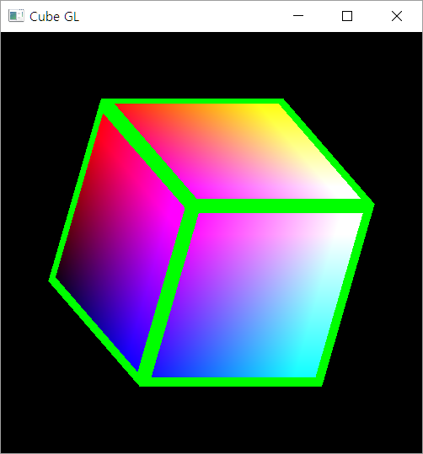
Summary
We learnt the very basic of defining geometry and use it on GPU
Today, we will learn how to code the shaders
Vertex Shader :
  Determining the positions of vertex
  Useful for scaling, rotating, deforming and so on.
  Also important for preparing some information sending to Fragment Shader
Fragment Shader :
  Determining the color of each fragment

Slide 20
GLSL Syntax Overview
GLSL is like C without
  Pointers
  Recursion
  Dynamic memory allocation
GLSL is like C with
  Built-in vector, matrix and sampler types
  Constructors
  A great math library
  Input and output qualifiers
Allow us to write concise, efficient shaders.

Slide 21
GLSL Syntax
GLSL has a preprocesssor
All Shaders have main()
#version 430
#ifdef FAST_EXACT_METHOD
FastExact();
#else
SlowApproximate();
#endif
// ... many others
void main(void)
{
}

Slide 22
GLSL Data Types
Scalar types: float, int, bool
Vector types: vec2, vec3, vec4
ivec2, ivec3, ivec4
bvec2, bvec3, bvec4
Matrix types: mat2, mat3, mat4
Texture sampling: sampler1D, sampler2D, sampler3D, samplerCube
C++ style constructors: vec3 a = vec3(1.0, 2.0, 3.0);
Notes:
As with any programming language, GLSL has types for variables. However, it includes vector-, and matrix-based types to simplify the operations that occur often in computer graphics.
In addition to numerical types, other types like texture samplers are used to enable other OpenGL operations. We’ll discuss texture samplers in the texture mapping section.

Slide 23
Operators
Standard C/C++ arithmetic and logic operators
Operators overloaded for matrix and vector operations
mat4 m;
vec4 a, b, c;
b = a*m;
c = m*a;
Notes:
The vector and matrix classes of GLSL are first-class types, with arithmetic and logical operations well defined. This helps simplify your code, and prevent errors.
Note in the above example, overloading ensures that both a*m and m*a are defined although they will not in general produce the same result.

Slide 24
Components and Swizzling
For vectors can use [ ], xyzw, rgba or stpq
Example:
vec3 v;
v[1], v.y, v.g, v.t all refer to the same element
Swizzling:
vec3 a, b;
a.xy = b.yx;
Notes:
For GLSL’s vector types, you’ll find that often you may also want to access components within the vector, as well as operate on all of the vector’s components at the same time. To support that, vectors and matrices (which are really a vector of vectors), support normal “C” vector accessing using the square-bracket notation (e.g., “[i]”), with zero-based indexing. Additionally, vectors (but not matrices) support swizzling, which provides a very powerful method for accessing and manipulating vector components.
Swizzles allow components within a vector to be accessed by name. For example, the first element in a vector – element 0 – can also be referenced by the names “x”, “s”, and “r”. Why all the names – to clarify their usage. If you’re working with a color, for example, it may be clearer in the code to use “r” to represent the red channel, as compared to “x”, which make more sense as the x-positional coordinate

Slide 25
GLSL Syntax: Vectors
Constructors
vec3 xyz = vec3(1.0, 2.0, 3.0);
vec3 xyz = vec3(1.0); // [1.0, 1.0, 1.0]
vec3 xyz = vec3(vec2(1.0, 2.0), 3.0);
vec3 xyz (1.0, 2.0, 3.0); // ← Error!

Slide 26
GLSL Syntax: Vectors
vec4 c = vec4(0.5, 1.0, 0.8, 1.0);
vec3 rgb = c.rgb; // [0.5, 1.0, 0.8]
vec3 bgr = c.bgr; // [0.8, 1.0, 0.5]
vec3 rrr = c.rrr; // [0.5, 0.5, 0.5]
c.a = 0.5; // [0.5, 1.0, 0.8, 0.5]
c.rb = 0.0; // [0.0, 1.0, 0.0, 0.5]
float g = rgb[1]; // 0.5, indexing, not swizzling

Slide 27
GLSL Syntax: Matrices
Matrices are built-in types:
  Square: mat2, mat3, mat4
  Rectangular: matmxn ( m columns, n rows)
  mat2x3, mat3x4, mat4x4
Stored column major

Slide 28
GLSL Syntax: Matrices
Constructors
Accessing elements
mat3 i = mat3(1.0); // 3x3 identity matrix
mat2 m = mat2(1.0, 2.0, // [1.0 3.0]
3.0, 4.0); // [2.0 4.0]
Column major!
Treat matrix as array of column vectors
float f = m[column][row];
float x = m[0].x; // x component of first column
vec2 yz = m[1].yz; // yz components of second column
Can swizzle too!

Slide 29
GLSL Syntax: Vectors and Matrices
Matrix and vector operations are easy and fast:
For more information:
  http://en.wikibooks.org/wiki/GLSL_Programming/Vector_and_Matrix_Operations
  http://en.wikibooks.org/wiki/GLSL_Programming/Applying_Matrix_Transformations
vec3 xyz = // ...
vec3 v0 = 2.0 * xyz; // scale
vec3 v1 = v0 + xyz; // component-wise
vec3 v2 = v0 * xyz; // component-wise
mat3 m = // ...
mat3 t = // ...
mat3 mt = t * m; // matrix * matrix
vec3 xyz2 = mt * xyz; // matrix * vector
vec3 xyz3 = xyz * mt; // vector * matrix ( = transposed_matrix * vector )

Slide 30
Qualifiers
in, out
  Copy vertex attributes and other variables to/from shaders
  in vec2 tex_coord;
  out vec4 color;
Uniform: variable from application
  uniform float time;
  uniform vec4 rotation;
Notes:
In addition to types, GLSL has numerous qualifiers to describe a variable usage. The most common of those are:
in qualifiers that indicate the shader variable will receive data flowing into the shader, either from the application, or the previous shader stage.
out qualifier which tag a variable as data output where data will flow to the next shader stage, or to the framebuffer
uniform qualifiers for accessing data that doesn’t change across a draw operation

Slide 31
GLSL Syntax: in/ out/ uniform
Uniform (constant) input
Vertex
Shader
Fragment
Shader
Streaming input
in
out
in
out
Color
gl_Position

Slide 32
GLSL Syntax: in/ out/ uniform
Example
uniform: shader input constant across glDraw
#version 430
uniform mat4 u_ModelView;
in vec3 Position;
in vec3 Color;
out vec3 fs_Color;
void main(void)
{
fs_Color = Color;
gl_Position = u_ModelView * vec4(Position, 1.0);
}
in: shader input varies per vertex attribute
out: shader output

Slide 33
Flow Control
if
if else
expression ? true-expression : false-expression
while, do while
for
Notes:
Like the “C” language, GLSL supports all of the logical flow control statements you’re used to.

Slide 34
Functions
Built in
  Arithmetic: sqrt, power, abs
  Trigonometric: sin, asin
  Graphical: length, reflect
User defined
Notes:
GLSL also provides a rich library of functions supporting common operations. While pretty much every vector- and matrix-related function available you can think of, along with the most common mathematical functions are built into GLSL, there’s no support for operations like reading files or printing values. Shaders are really data-flow engines with data coming in, being processed, and sent on for further processing.

Slide 35
Built-in Variables
gl_Position: output position from vertex shader
gl_FragColor: output color from fragment shader
  Only for ES, WebGL and older versions of GLSL
  Present version use an out variable
Notes:
Fundamental to shader processing are a couple of built-in GLSL variable which are the terminus for operations. In particular, vertex data, which can be processed by up to for shader stages in OpenGL are all ended by setting a positional value into the built-in variable, gl_Position. Similarly, the output of a fragment shader (in version 3.1 of OpenGL) is set by writing values into the built-in variable gl_FragColor. Later versions of OpenGL allow fragment shaders to output to other variables of the user’s designation as well.

Slide 36
Simple Vertex Shader for Cube
#version 330
in vec4 vPosition;
in vec4 vColor;
out vec4 color;
void main() {
color = vColor;
gl_Position = vPosition;
}
Notes:
Here’s the simple vertex shader we use in our cube rendering example. It accepts two vertex attributes as input: the vertex’s position and color, and does very little processing on them; in fact, it merely copies the input into some output variables (with gl_Position being implicitly declared). The results of each vertex shader execution are passed further down the OpenGL pipeline, and ultimately end their processing in the fragment shader.

Slide 37
The Simplest Fragment Shader
#version 330
in vec4 color;
out vec4 FragColor;
void main() {
FragColor = color;
}
Notes:
Here’s the associated fragment shader that we use in our cube example. While this shader is as simple as they come – merely setting the fragment’s color to the input color passed in, there’s been a lot of processing to this point. In particular, every fragment that’s shaded was generated by the rasterizer, which is a built-in, non-programmable (i.e., you don’t write a shader to control its operation). What’s magical about this process is that if the colors across the geometric primitive (for multi-vertex primitives: lines and triangles) is not the same, the rasterizer will interpolate those colors across the primitive, passing each iterated value into our color variable.

Slide 38
Using Shaders: A Simpler Way
We’ve created a routine for this course to make it easier to load your shaders
  available at course website:
GLuint InitShader (char* vFile, char* fFile);
InitShaders takes two filenames
  vFile for the vertex shader
  fFile for the fragment shader
Fails if shaders don’t compile, or program doesn’t link
Notes:
To simplify our lives, we created a routine that simplifies loading, compiling, and linking shaders: InitShaders(). It implements the shader compilation and linking process shown on the previous slide. It also does full error checking, and will terminate your program if there’s an error at some stage in the process (production applications might choose a less terminal solution to the problem, but it’s useful in the classroom).
InitShaders() accepts two parameters, each a filename to be loaded as source for the vertex and fragment shader stages, respectively.
The value returned from InitShaders() will be a valid GLSL program id that you can pass into glUseProgram().

Slide 39
Determining Locations After Linking
Assumes you already know the variables’ name
  GLint idx =
  glGetAttribLocation(program, “name”);
  GLint idx =
  glGetUniformLocation(program, “name”);
Notes:
Once you know the names of variables in a shader – whether they’re attributes or uniforms – you can determine their location using one of the glGet*Location() calls.
If you don’t know the variables in a shader (if, for instance, you’re writing a library that accepts shaders), you can find out all of the shader variables by using the glGetActiveAttrib() function.

Slide 40
Vertex Attributes Setting
// set up vertex arrays (after shaders are loaded)
GLuint vPosition = glGetAttribLocation(program, "vPosition”);
glEnableVertexAttribArray(vPosition);
glVertexAttribPointer(vPosition, 4, GL_FLOAT, GL_FALSE, 0, BUFFER_OFFSET(0));
GLuint vColor = glGetAttribLocation(program, "vColor”);
glEnableVertexAttribArray(vColor);
glVertexAttribPointer(vColor, 4, GL_FLOAT, GL_FALSE, 0, BUFFER_OFFSET(sizeof(points)));
Notes:
To complete the “plumbing” of associating our vertex data with variables in our shader programs, you need to tell OpenGL where in our buffer object to find the vertex data, and which shader variable to pass the data to when we draw. The above code snippet shows that process for our two data sources. In our shaders (which we’ll discuss in a moment), we have two variables: vPosition, and vColor, which we will associate with the data values in our VBOs that we copied form our vertex_positions and vertex_colors arrays.
The calls to glGetAttribLocation() will return a compiler-generated index which we need to use to complete the connection from our data to the shader inputs. We also need to “turn the valve” on our data by enabling its attribute array by calling glEnableVertexAttribArray() with the selected attribute location.
This is the most flexible approach to this process, but depending on your OpenGL version, you may be able to use the layout construct, which allows you to specify the attribute location, as compared to having to retrieve it after compiling and linking your shaders. We’ll discuss that in our shader section later in the course.
BUFFER_OFFSET is a simple macro defined to make the code more readable
#define BUFFER_OFFSET( offset ) ((GLvoid*) (offset))

Slide 41
Initializing Uniform Variable Values
Uniform Variables
  glUniform1f(index, value);
  glUniform4f(index, x, y, z, w);
  Glboolean transpose = GL_TRUE;
  // Since we’re C programmers
  Glfloat mat[3][4][4] = { … };
  glUniformMatrix4fv(index, 3, transpose, mat);
row
column
Notes:
You’ve already seen how one associates values with attributes by calling glVertexAttribPointer(). To specify a uniform’s value, we use one of the glUniform*() functions. For setting a vector type, you’ll use one of the glUniform*() variants, and for matrices you’ll use a glUniformMatrix *() form.

Slide 42
Shader Applications
Moving vertices
  Morphing
  Wave motion
  Fractals
Lighting
  More realistic models
  Cartoon shaders
And more and more!

Slide 43
Interaction:
Callbacks

Slide 44
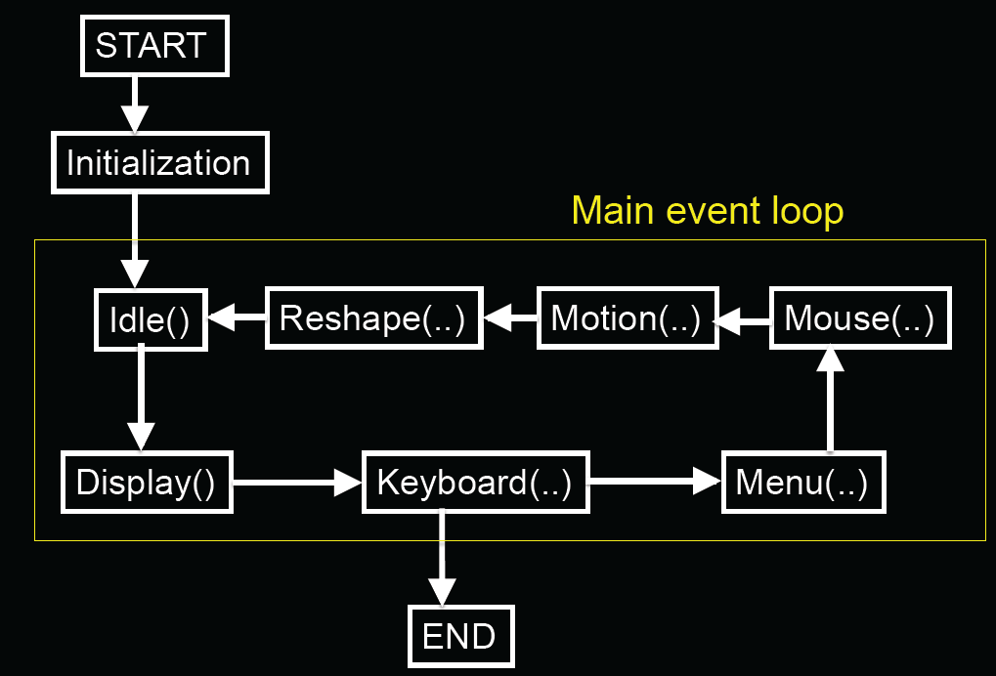
GLUT Program with Callbacks

Slide 45
Event Types
Window: resize, expose, iconify
Mouse: click one or more buttons
Motion: move mouse
Keyboard: press or release a key
Idle: non-event
  Define what should be done if no other event is in queue
E. Angel and D. Shreiner : Interactive Computer Graphics 6E © Addison-Wesley 2012

Slide 46
Callbacks
Programming interface for event-driven input
Define a callback function for each type of event the graphics system recognizes
This user-supplied function is executed when the event occurs
GLUT example: glutMouseFunc(mymouse)
mouse callback function
E. Angel and D. Shreiner : Interactive Computer Graphics 6E © Addison-Wesley 2012

Slide 47
GLUT callbacks
GLUT recognizes a subset of the events recognized by any particular window system (Windows, X, Macintosh)
  glutDisplayFunc
  glutMouseFunc
  glutReshapeFunc
  glutKeyboardFunc
  glutIdleFunc
  glutMotionFunc, glutPassiveMotionFunc
E. Angel and D. Shreiner : Interactive Computer Graphics 6E © Addison-Wesley 2012

Slide 48
Types of Callbacks
Display ( ) : when window must be drawn
Idle ( ) : when no other events to be handled
Keyboard (unsigned char key, int x, int y) : key pressed
Menu (...) : after selection from menu
Mouse (int button, int state, int x, int y) : mouse button
Motion (...) : mouse movement
Reshape (int w, int h) : window resize
Any callback can be NULL

Slide 49
GLUT Event Loop
Recall that the last line in main.c for a program using GLUT must be
  glutMainLoop();
which puts the program in an infinite event loop
In each pass through the event loop, GLUT
  looks at the events in the queue
  for each event in the queue, GLUT executes the appropriate callback function if one is defined
  if no callback is defined for the event, the event is ignored
E. Angel and D. Shreiner : Interactive Computer Graphics 6E © Addison-Wesley 2012

Slide 50
Example : Idling Callback
Idling Callback is useful for defining a periodic work
  Ex. ) making an animation (rotating a cube and so on)
How to use:
  Registering your function as an Idling Callback Function
  Implement what you want to do repeatedly
glutIdleFunc ( myIdle );
void myIdle()
{
// do some periodic job
Sleep(16);
glutPostRedisplay();
}
Wait for 16 mille-sec.
(Ensuring 60 FPS)
Invoking redrawing

Slide 51
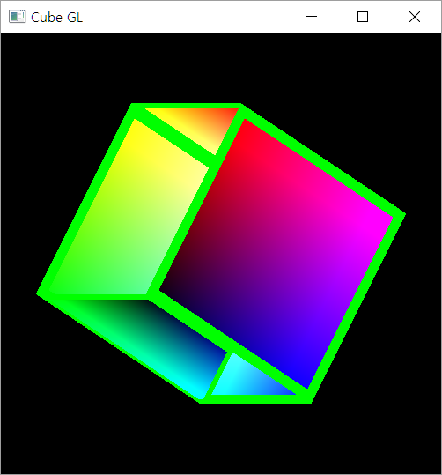
One little problem
Incorrect Depth Handling

Slide 52
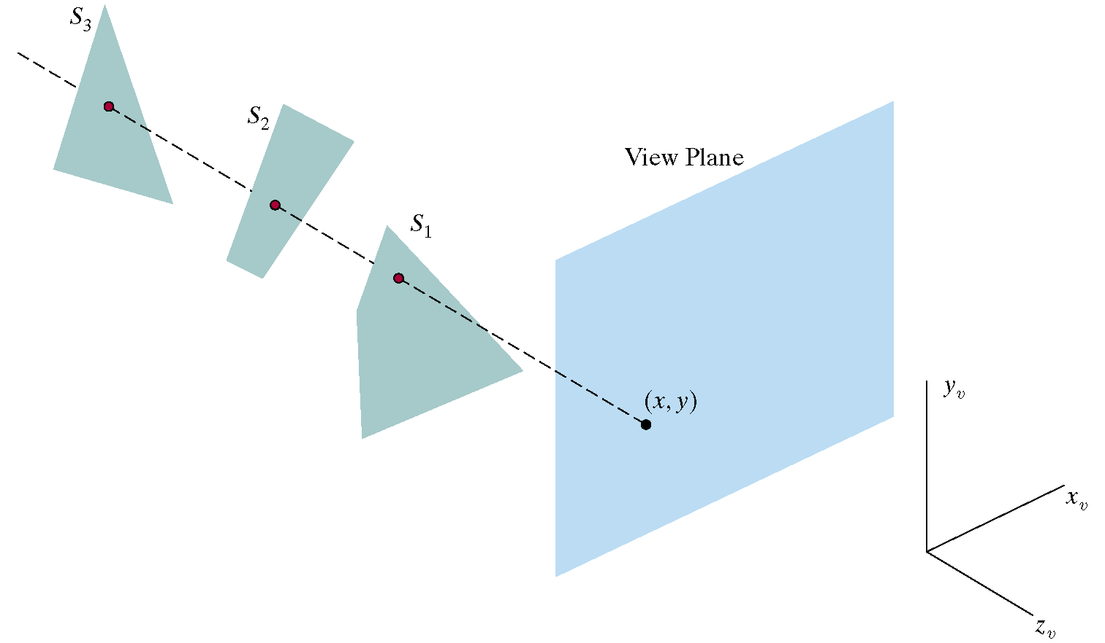
Depth-Buffer (Z-Buffer)
Z-Buffer has memory corresponding to each pixel location for storing the current depth value (distance from view plane)
  Useful for determining whether a new drawing pixel is visible or not
    Is visible when the its distance is closer than the previously stored one
    Is not visible when it is farer

Slide 53
Enabling the Depth Buffer in OPENGL
On Initialization :
On Drawing :
glutInitDisplayMode(GLUT_DOUBLE |
GLUT_RGBA |
GLUT_DEPTH);
glClear (GL_COLOR_BUFFER_BIT |
GL_DEPTH_BUFFER_BIT);
glEnable(GL_DEPTH_TEST);

